Slide 1
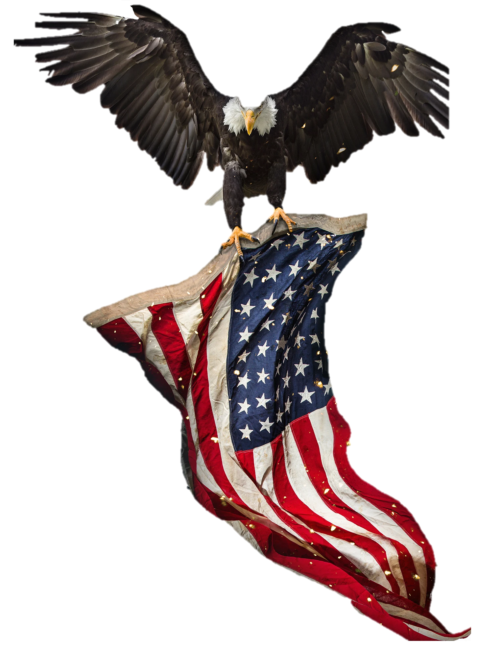
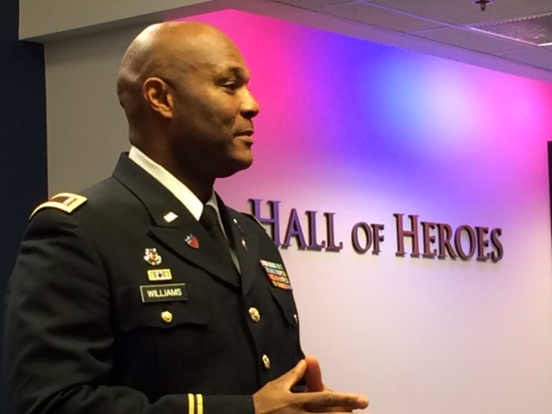
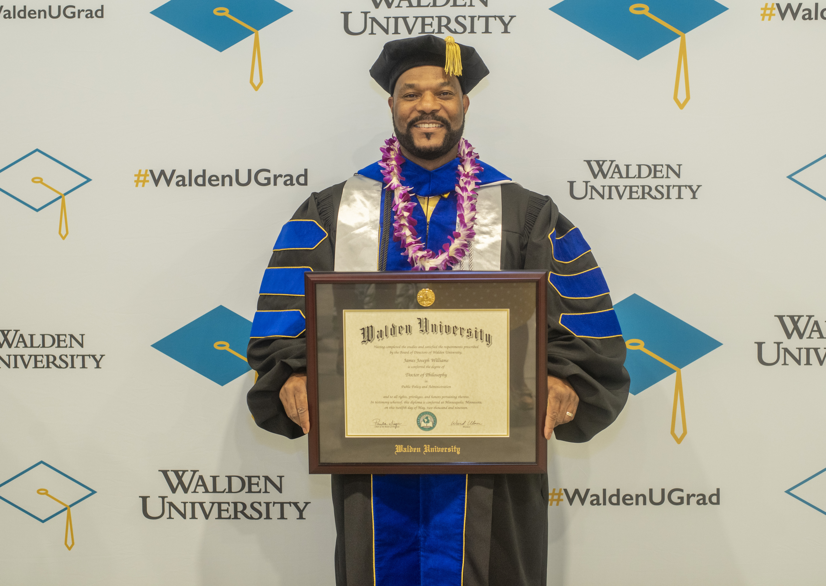
1MANSHO PRODUCTIONS, LLC
PROUDLY PRESENTS
RISING Above The Fray
A DOCUMENTARY :
LiVED EXPERIENCES OF AFRICAN AMERICAN ARMY WARRANT OFFICERS
Dr. James J. Williams - CW5 (Ret), United States army
FOUNDER - CREATOR - EXECUtive PRODUCER
Prescreen date – fall 2022

Slide 2
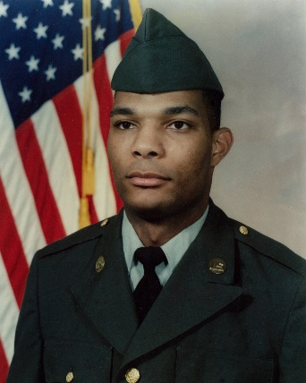
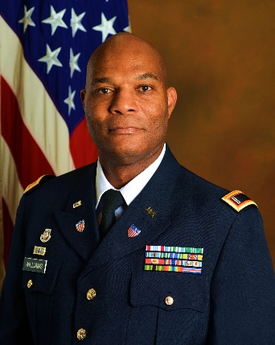



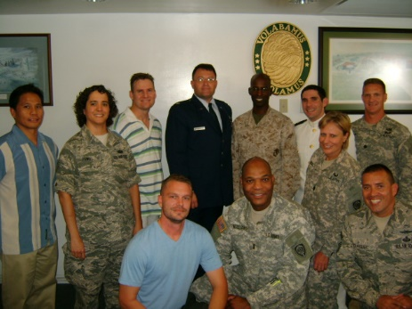
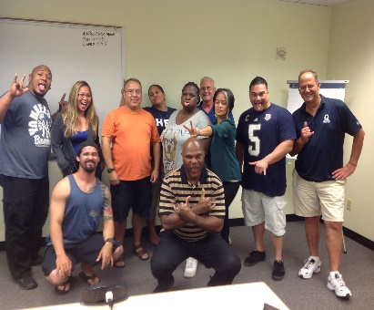
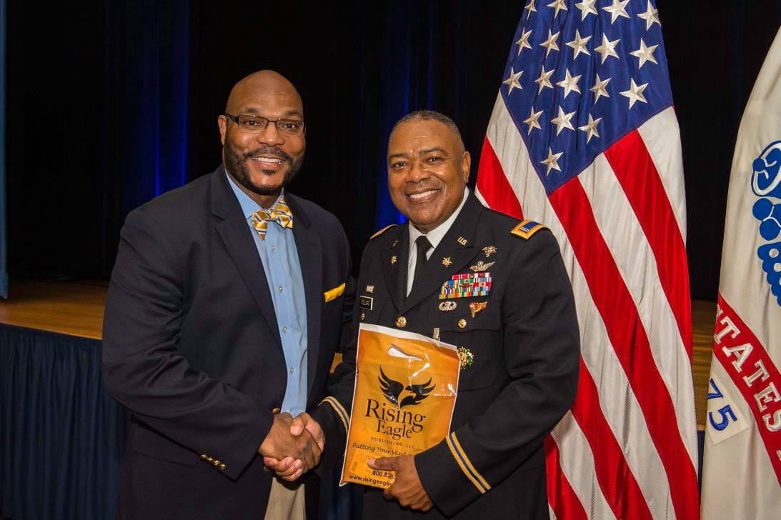
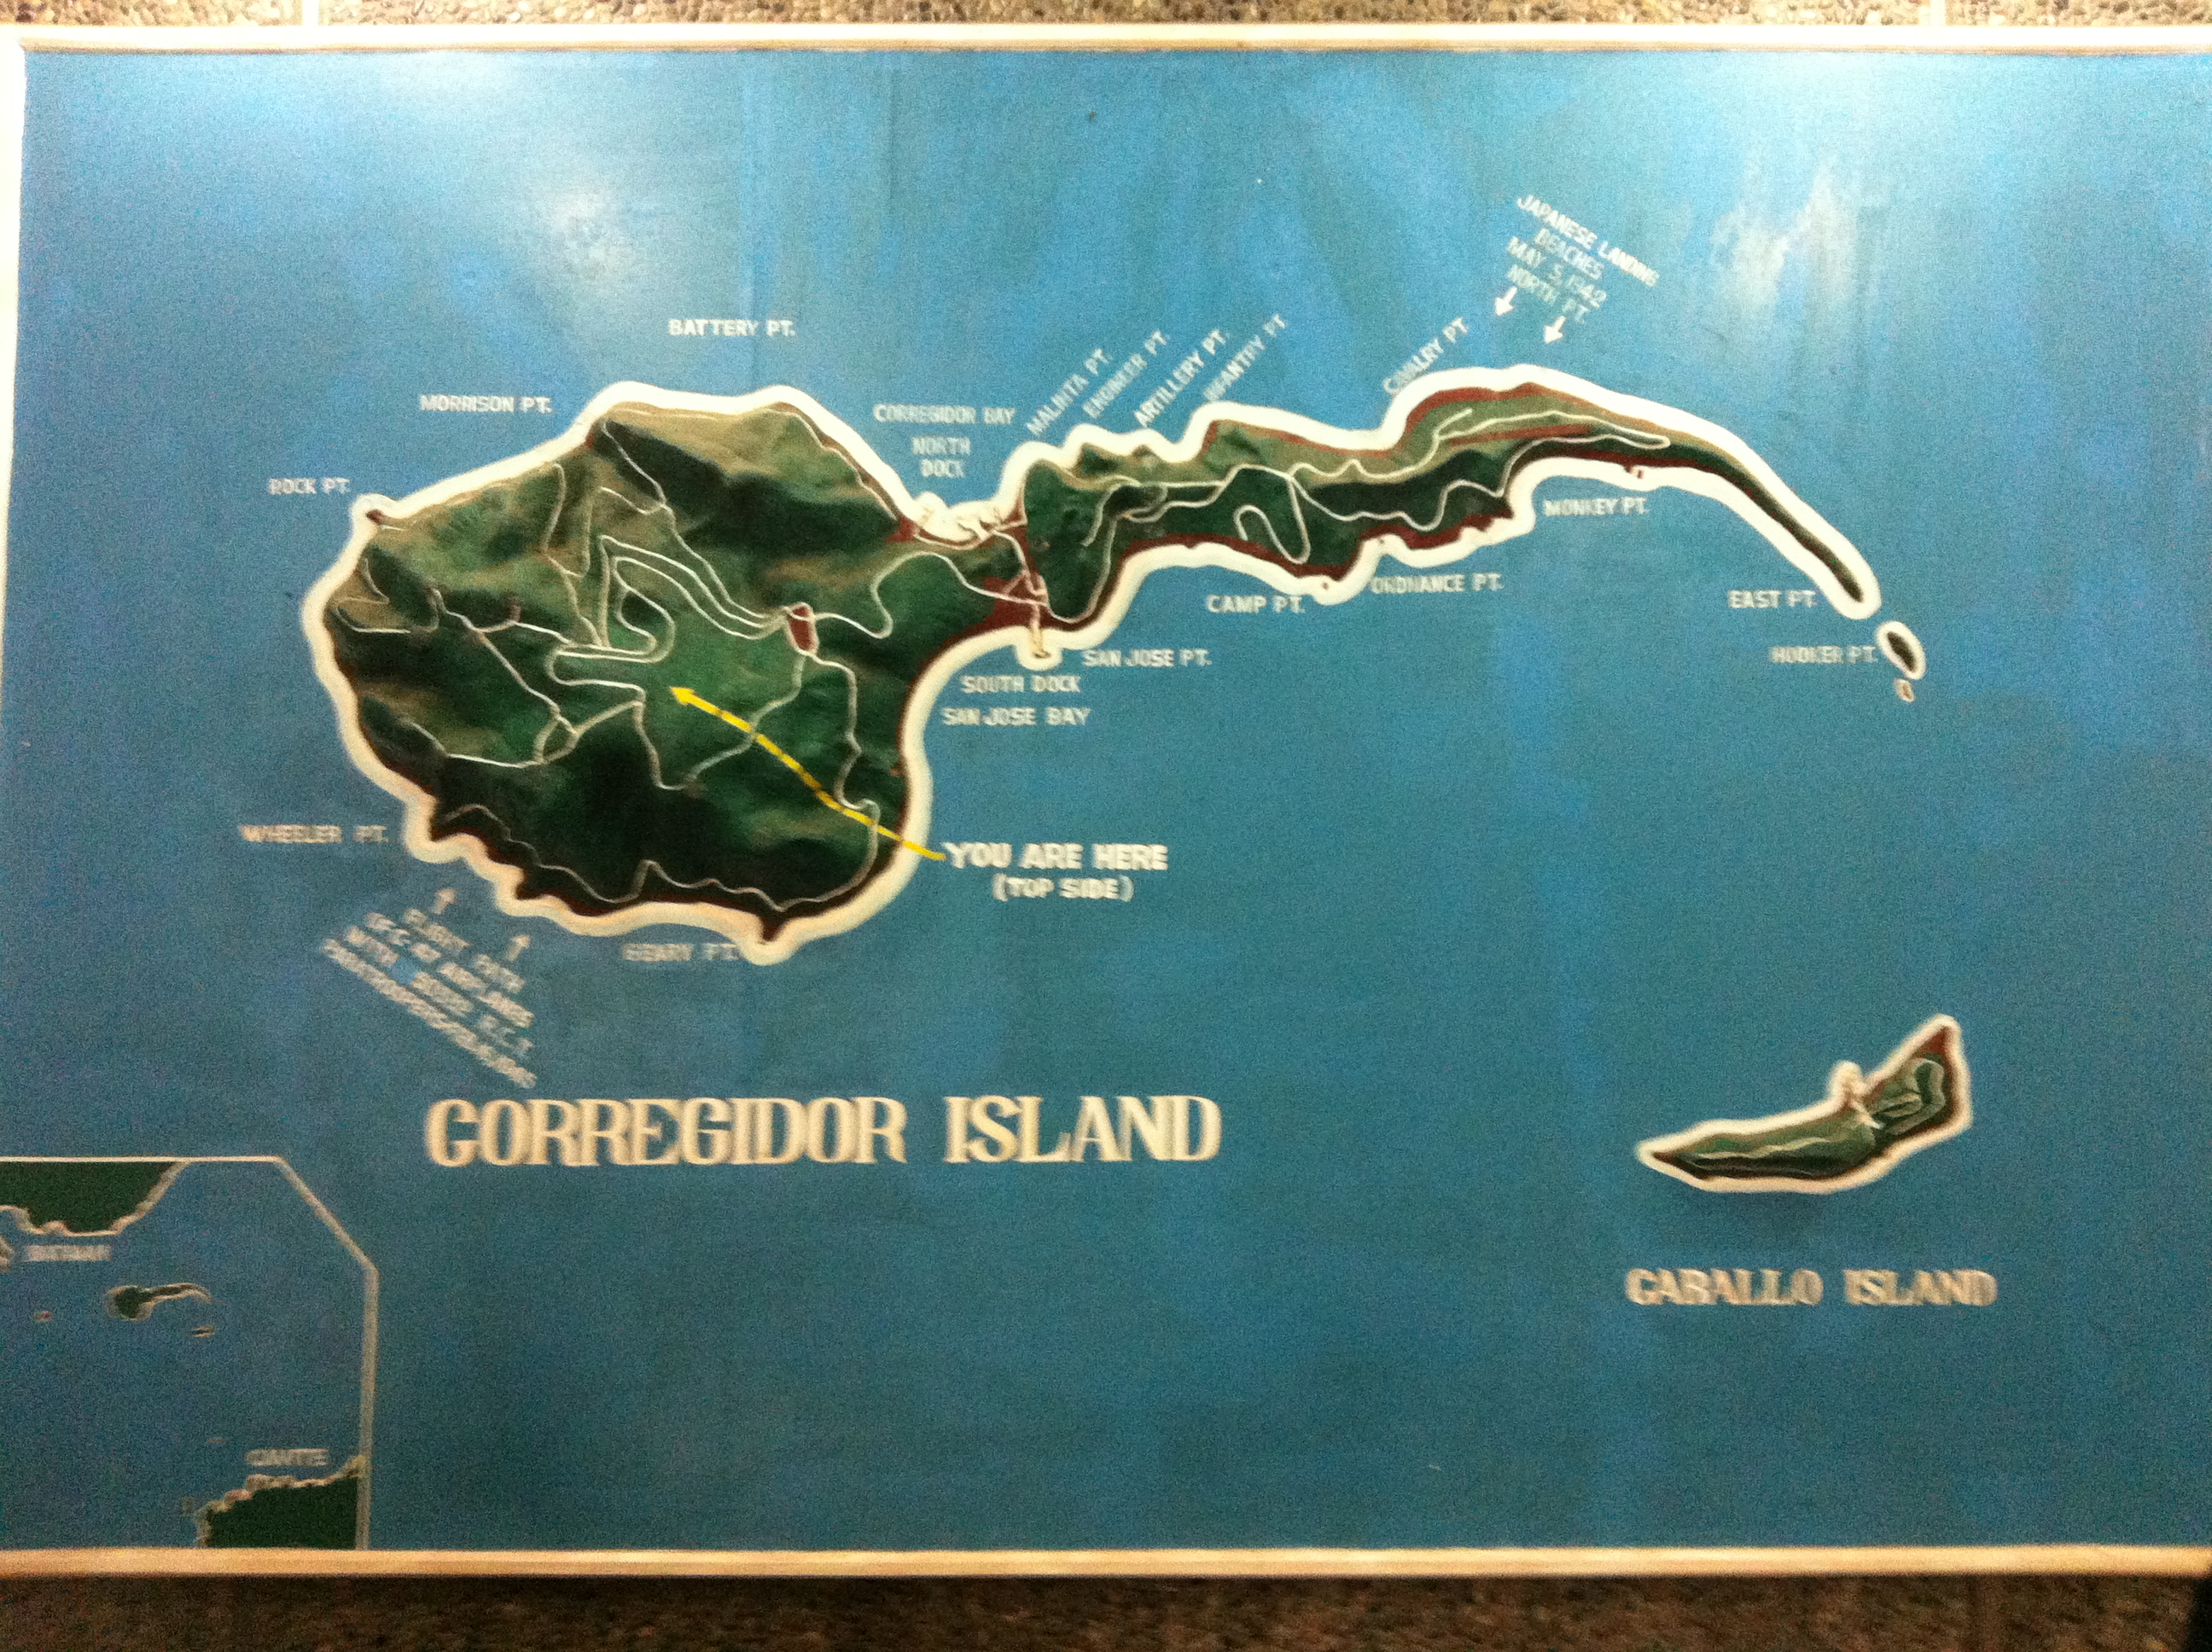
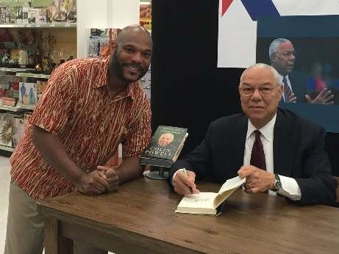

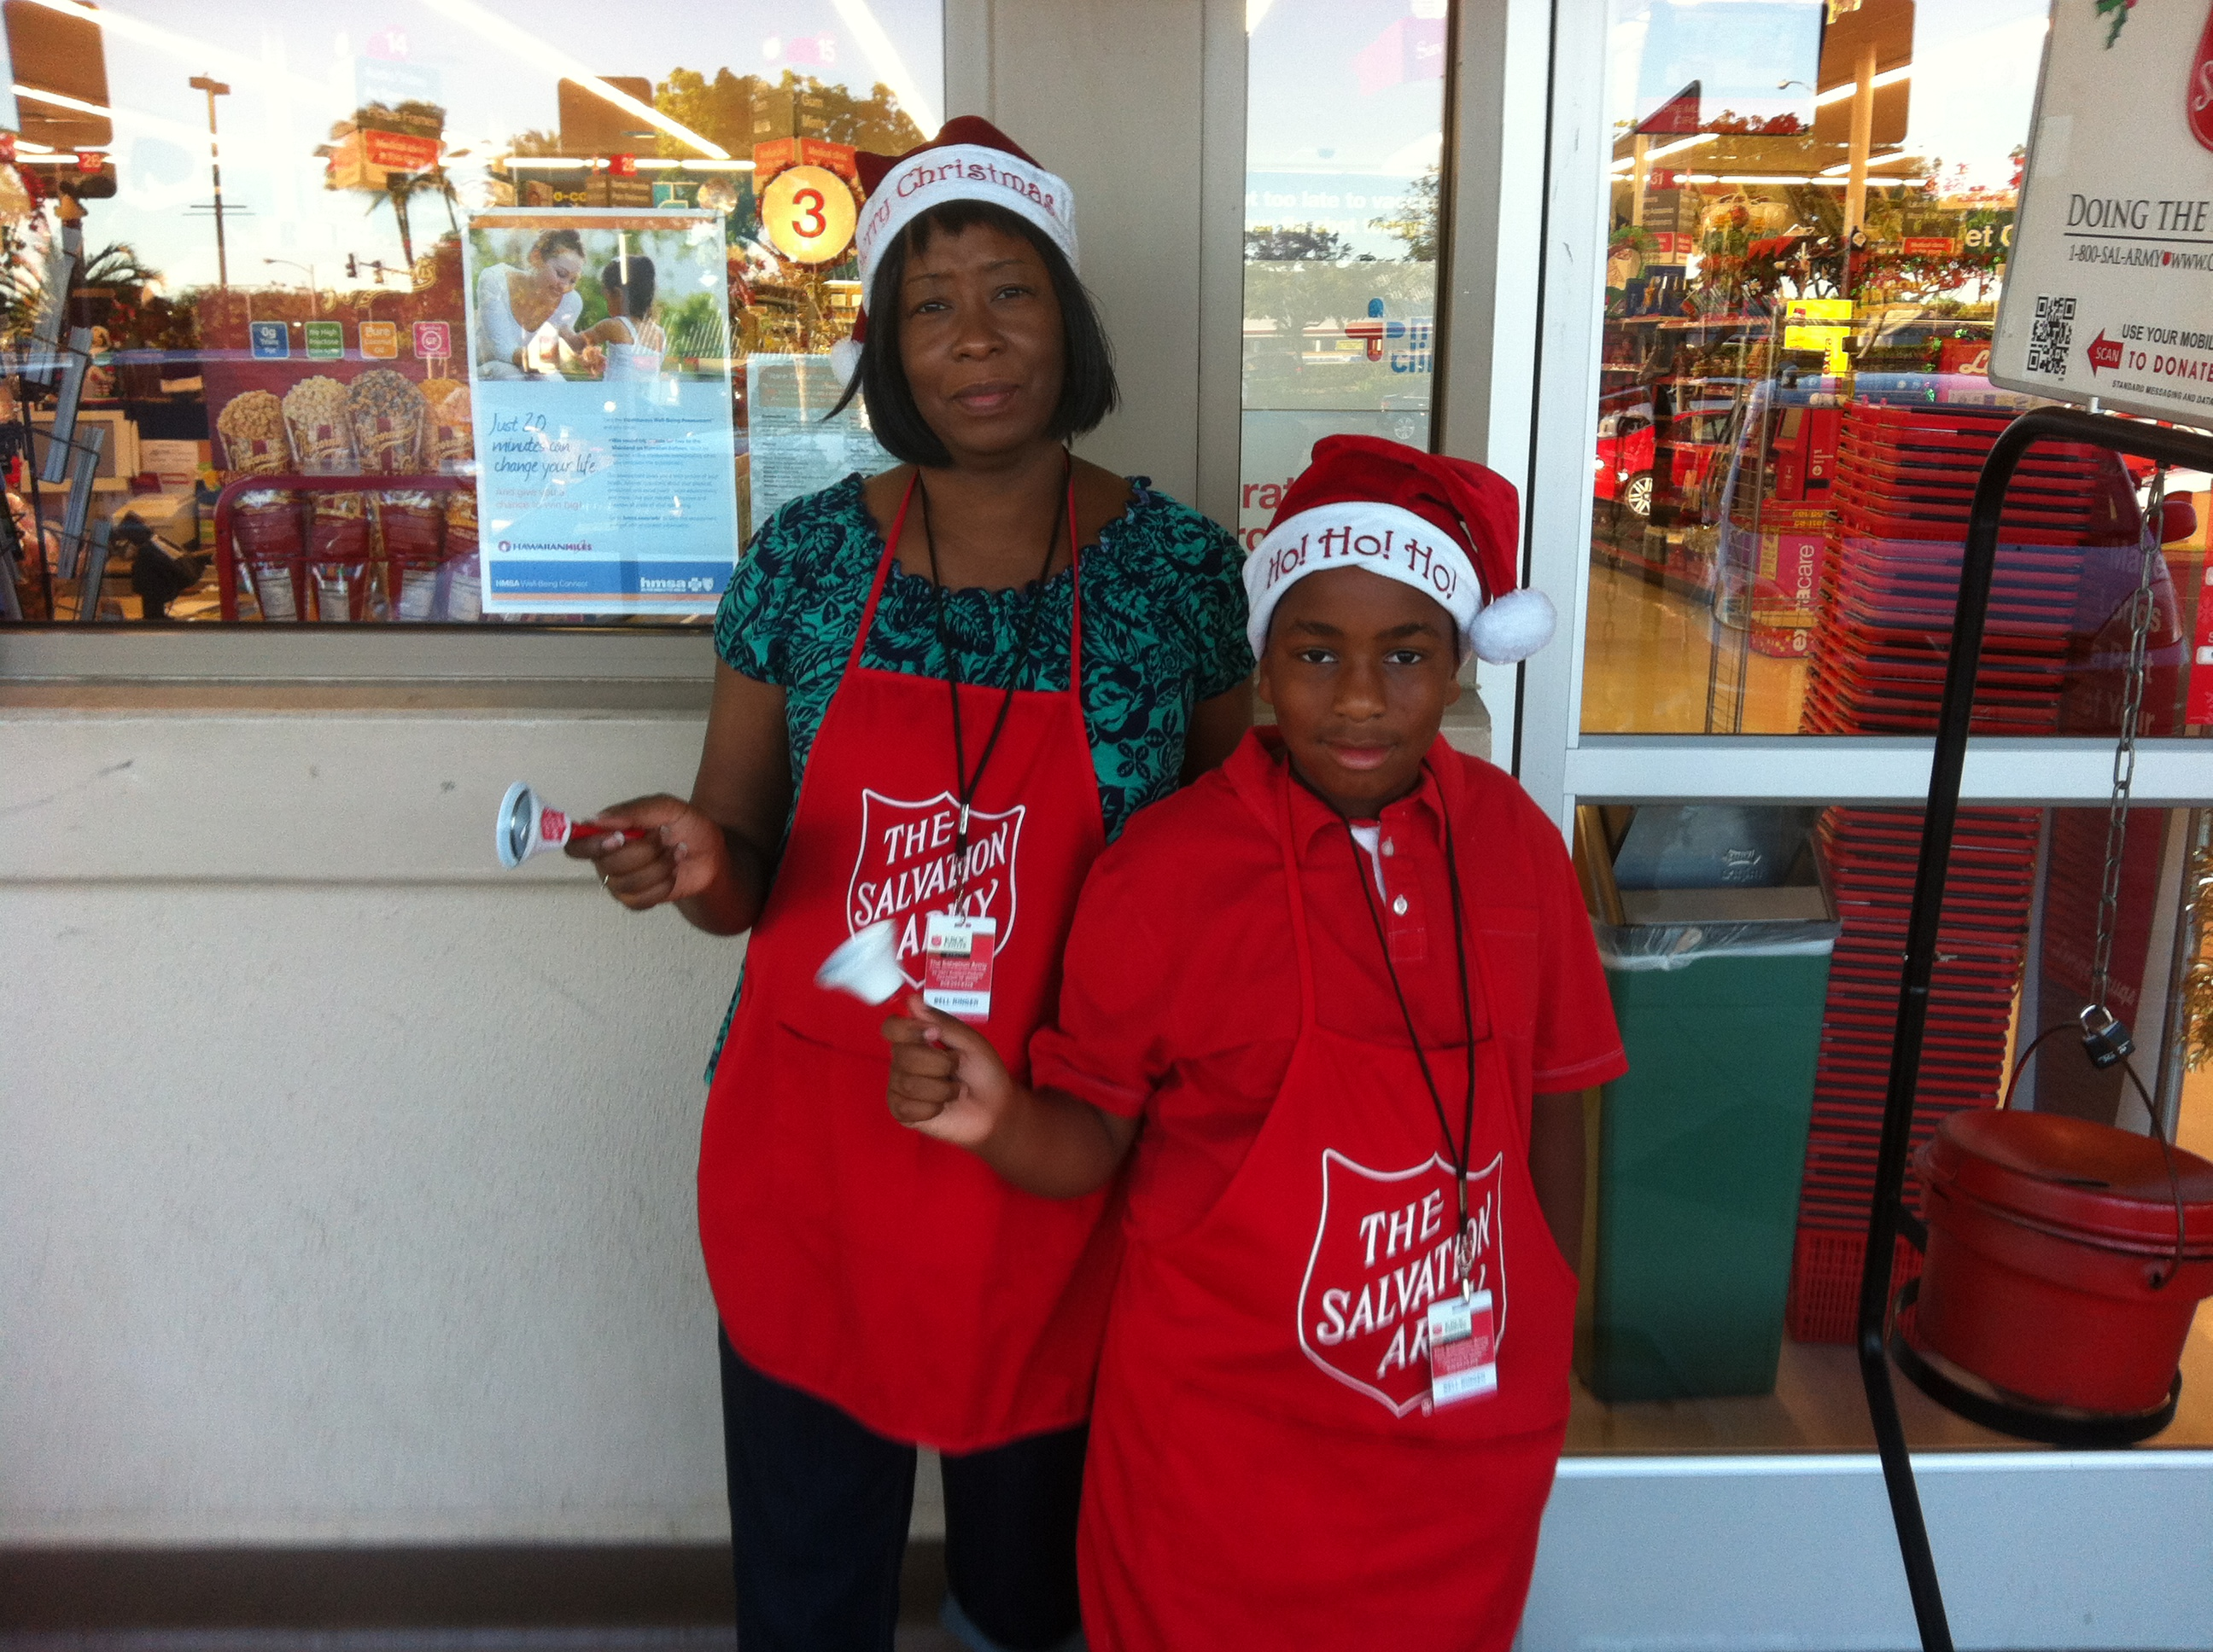
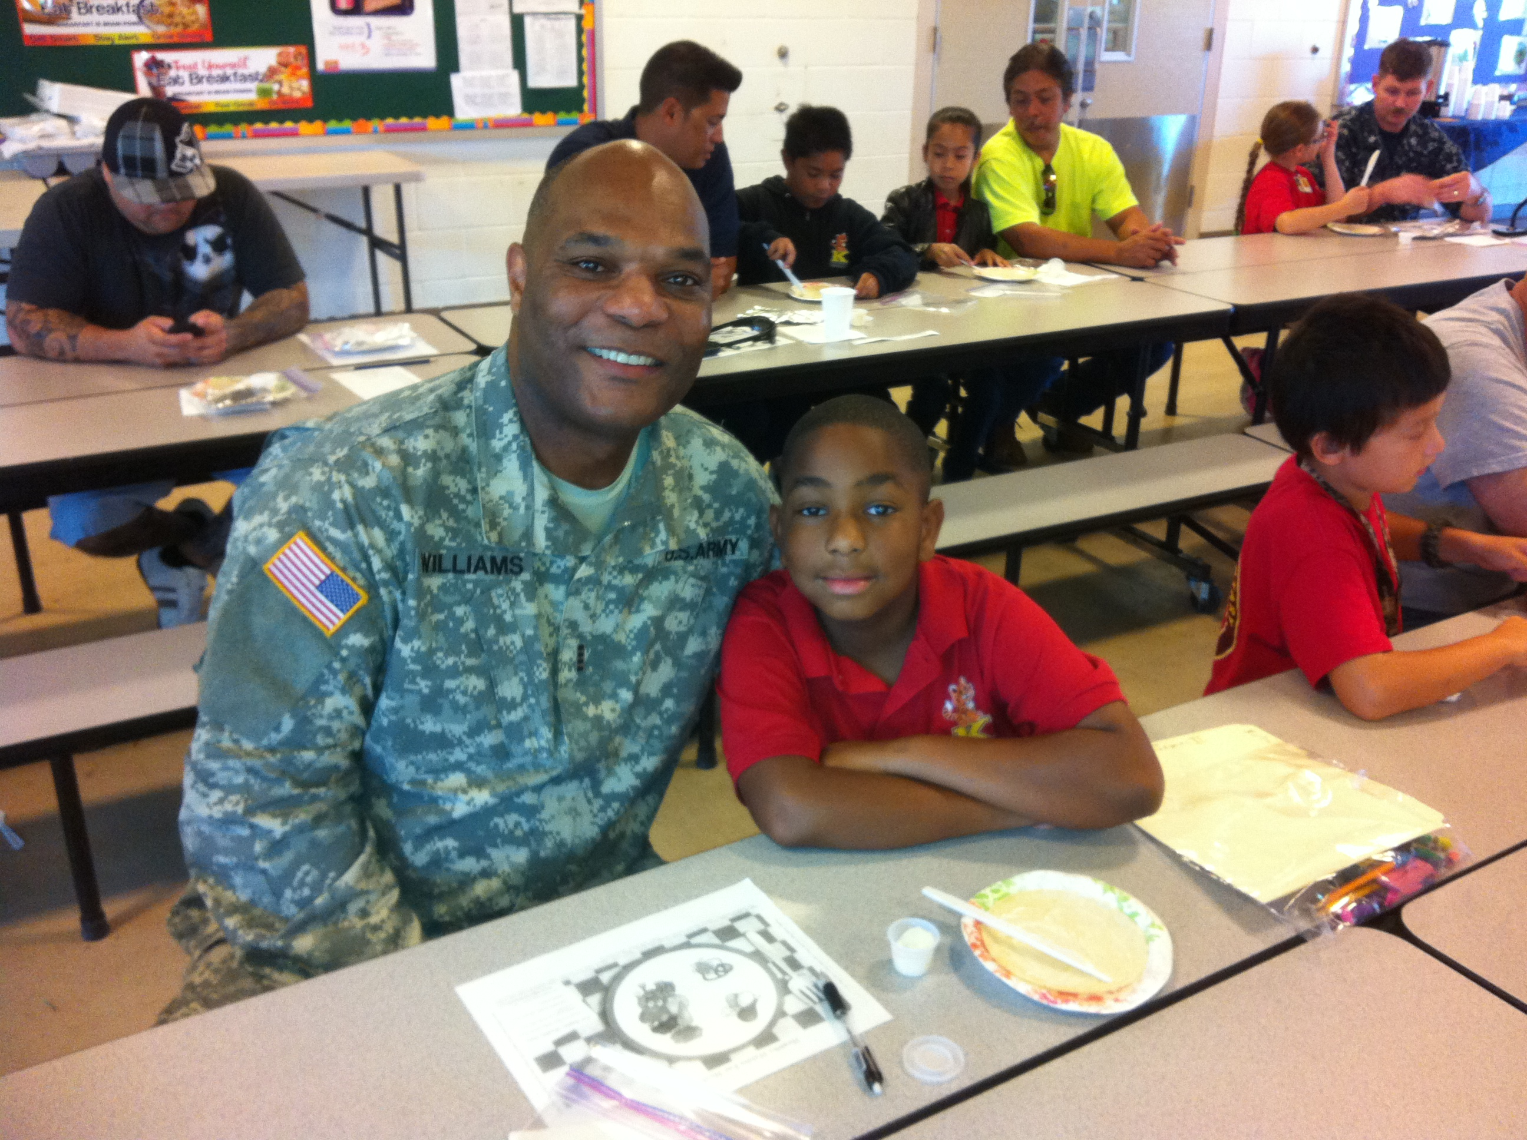
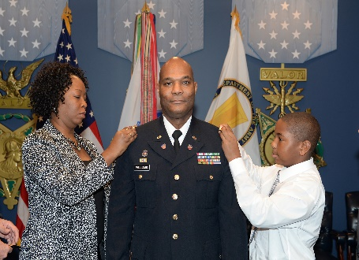
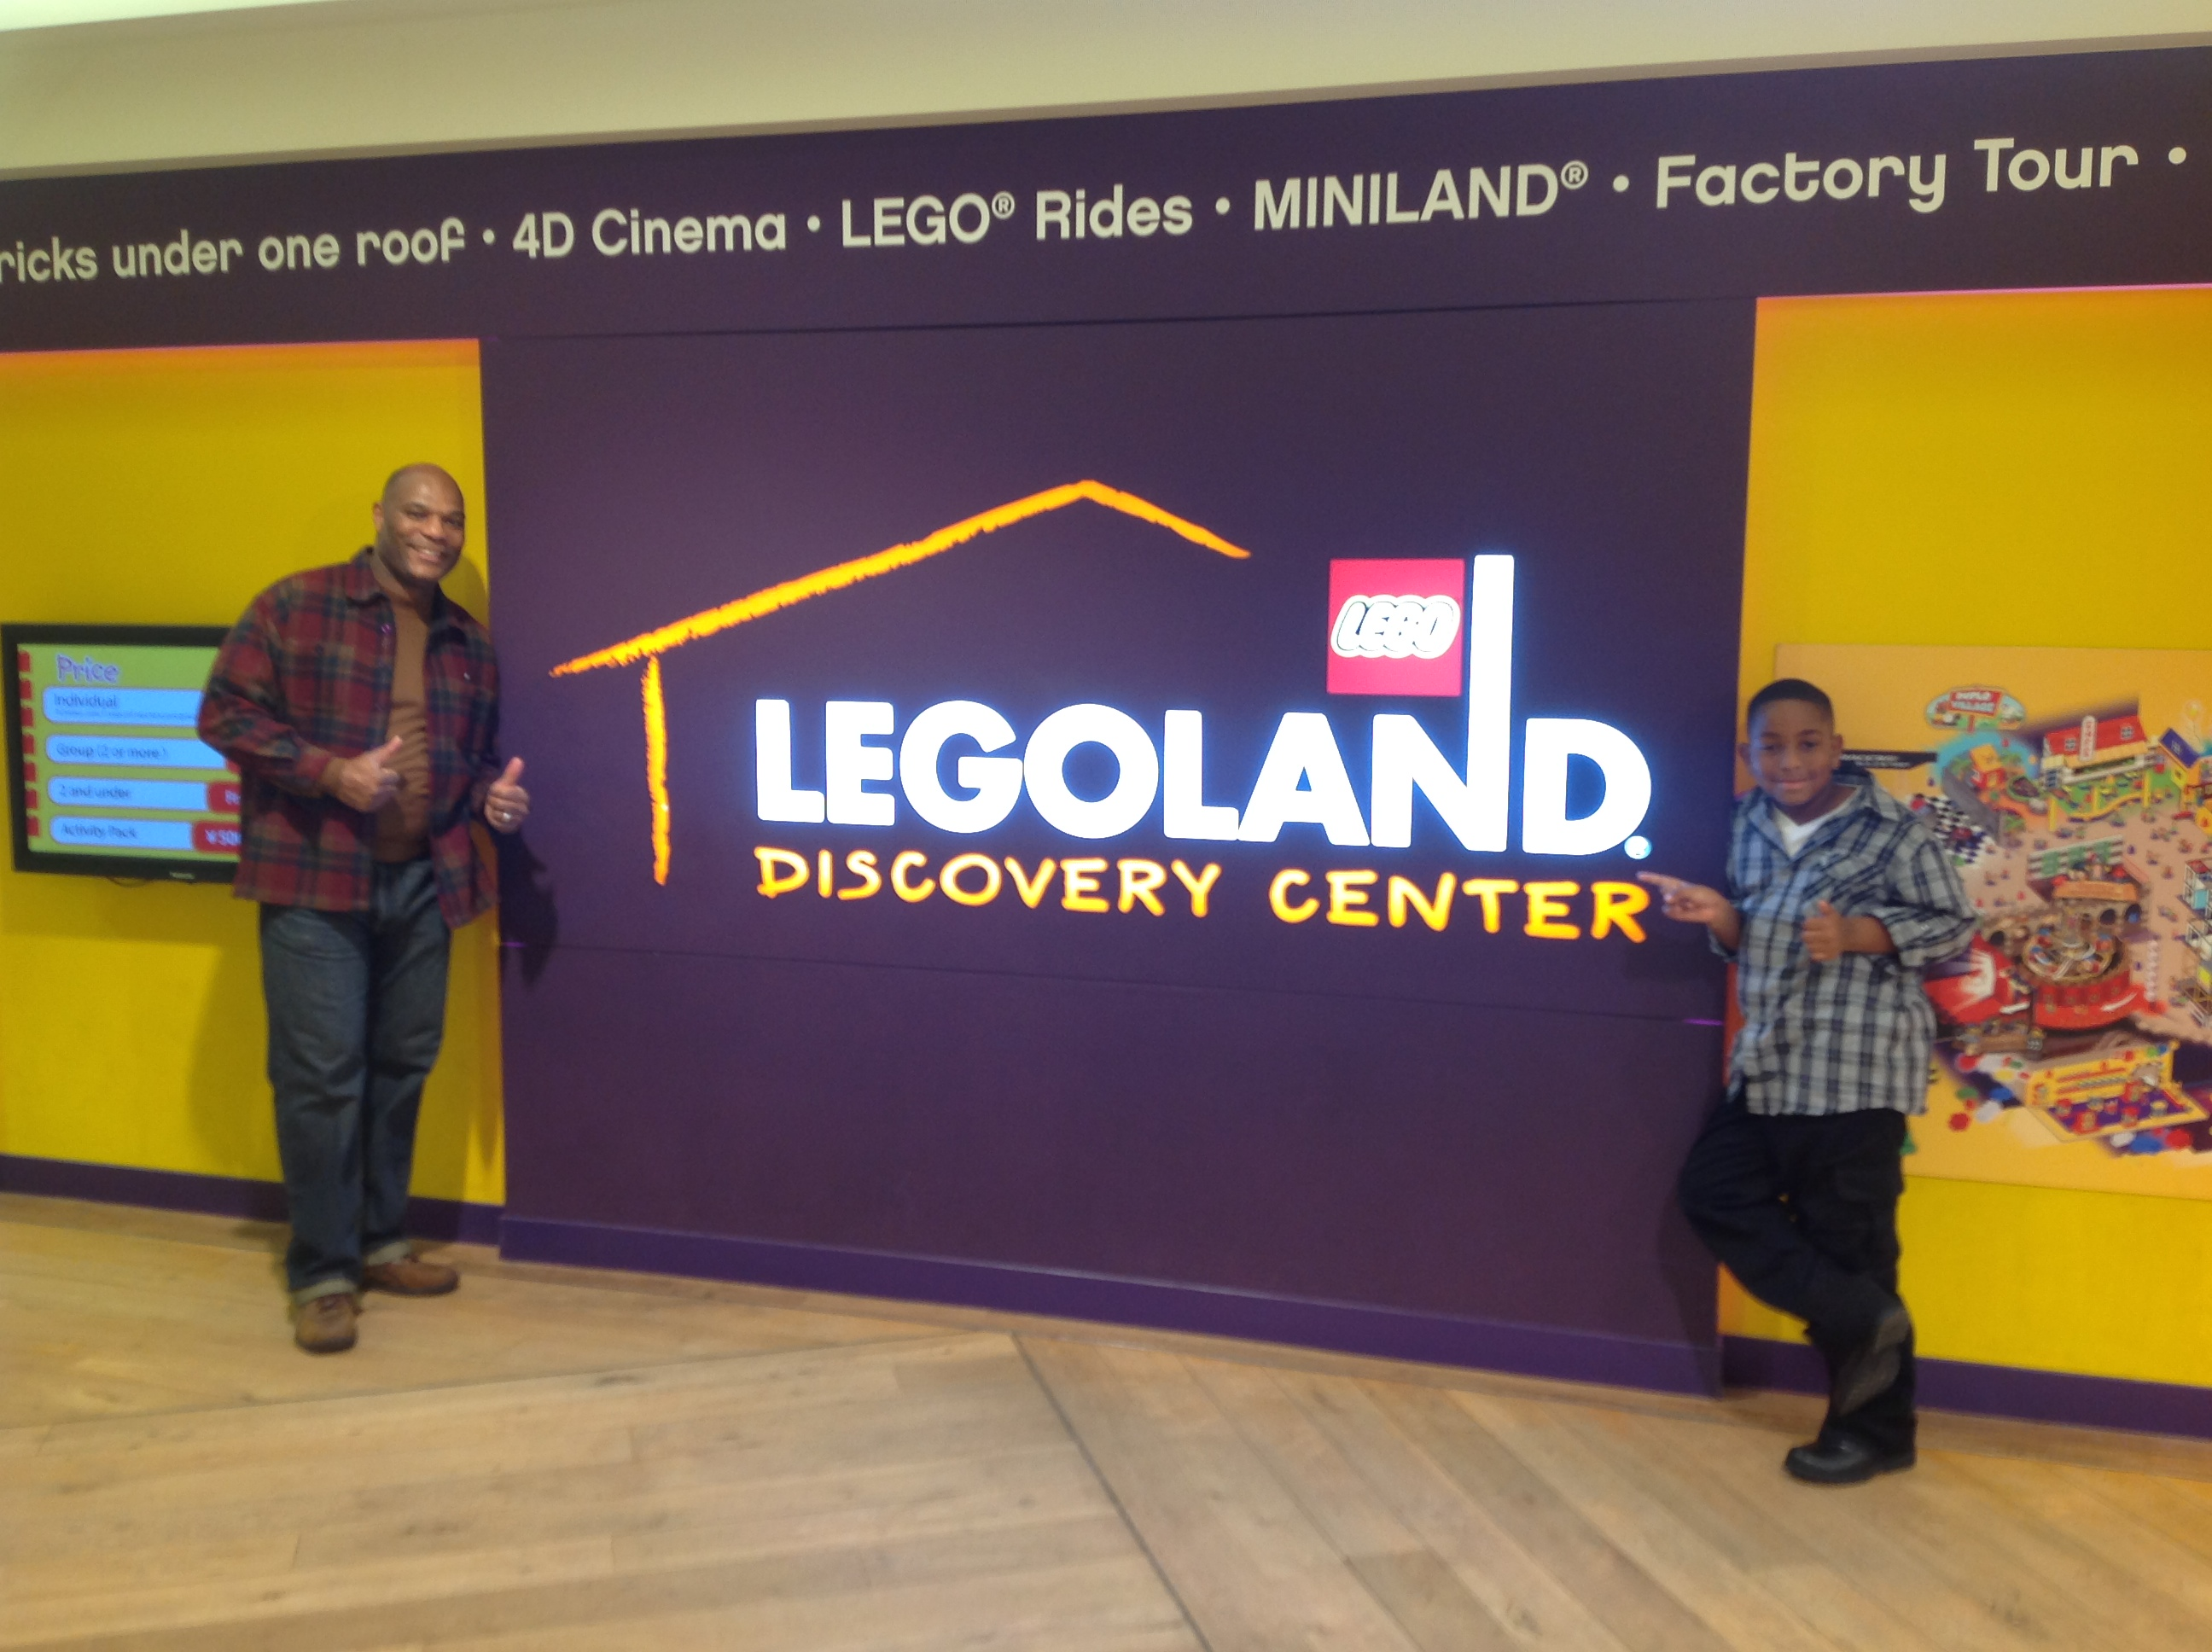
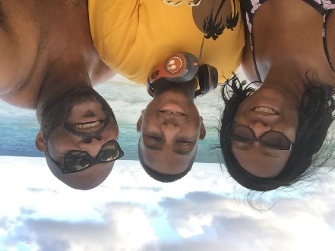
Native of Cleveland, Ohio
31 years military service - 1 Oct 2019 (retirement) Cyber Systems Engineer/Manager - Peraton, Inc.
Award-winning author/Best-selling co-author
Columnist - Next Generation Speakers Magazine
Adjunct Professor - Stevenson University
Bachelor of Science CIS & MPA - Strayer University
Ph.D. Public Mgt & Leadership - Walden University
Quote of the Day:
There is no elevator to success…take the stairs!!!

Slide 3
1ManSho Productions Mission Statement
1ManSho Productions seeks to uncover and produce empowering untold stories that take on new perspectives with the intent to educate, uplift and inspire
Our mission is to highlight and preserve the accomplishments and contributions of non-fiction and scholarly works including:
Honorably preserving and representing the contributions and Legacy of the
African American
Warrant Officer

Slide 4
Purpose of Study
The focus of this phenomenological research study is to capture lived experiences of African-American men who achieved the highest rank of CW5
Provide a blueprint for aspiring soldiers in all branches of service in navigating their military career path

Slide 5

Why This Study?
No data of blacks who served prior to 1941
Barriers to promotion in the WOC (W1-W5)
Fewer AAM in the highest ranks (CW5)
No captured experiences for those AAM who achieved CW5 rank
  Success Strategies
  Motivational Factors
Warrant Officer Corps (WOC)
Established
1918

Slide 6
Research Questions
RQ1
How do retired African-American male officers describe their experience of attaining the rank of senior field grade warrant officer (CW5/W5) in the United States Army Warrant Officer Corps?
SQ1
What are the experiences which shaped the achievements of African-American men serving in senior leadership positions in the Army Warrant Officer Corps?
SQ2
What strategies do African-American men believe they used to reach the rank of Senior Field Grade Warrant Officer?

Slide 7
Method/Design
The research is a qualitative study in order to add to the literature of the Army warrant officer population
The selected research design for this study is phenomenological study which allows the researcher to capture the lived experiences of the participant
Modified van Kam method by Moustakas (1994) allows the researcher to investigate the lived experiences of the participant

Slide 8
Participants/Sample Size
Snowball sample size (population 300)
32 respondents/15 Finalists
10 Participants/Final sample size for the study
Inclusion/Exclusion criteria for participants
  African-American men
  U.S. Army warrant officers
  Retirees at the rank of CW5

Slide 9
Demographic Characteristic Data

Slide 10
Emerging Themes
T-1 – Competence in Primary Functional Area
T-2 – Aspiration
T-3 – Overcoming Barriers to Promotion
T-4 – Proven Leadership Style
T-5 – Mentorship
T-6 – Educational Opportunities
T-7 – Establish a Career Roadmap
T-8 – Excel Through Army Promotion System
T-9 – Faith

Slide 11
Research Question Results – RQ1
RQ1 - How do retired African-American male officers describe their experience of attaining the rank of senior field grade warrant officer (CW5/W5) in the United States Army Warrant Officer Corps?
  T-2 Aspiration
  T-6 Educational Opportunities

Slide 12
Research Question Results – SQ1
SQ1 – What are the experiences which shaped the achievements of African-American men serving in leadership?
  T-3 Overcoming barriers to promotion
  T-5 Mentorship
  T-9 Faith

Slide 13
Research Question Results – SQ2
SQ2 – What are the strategies do African-American men believe they used to reach the rank of CW5?
  T-1 Competence in Primary Functional Area
  T-4 Proven Leadership Style
  T-8 Excel Through Army Promotion System
  T-7 Establish a Career Roadmap

Slide 14
Social Change Implications
Future study expansion to add to the literature not yet explored and provide a blueprint for future soldiers aspiring to join the WOC
The research aims to inform senior leaders, recruiters and policy makers how better recruitment of the minority population will yield a diverse military force
Model used in public and private sector to create a diverse workforce of African-Americans serving in senior executive leadership positions

Slide 15
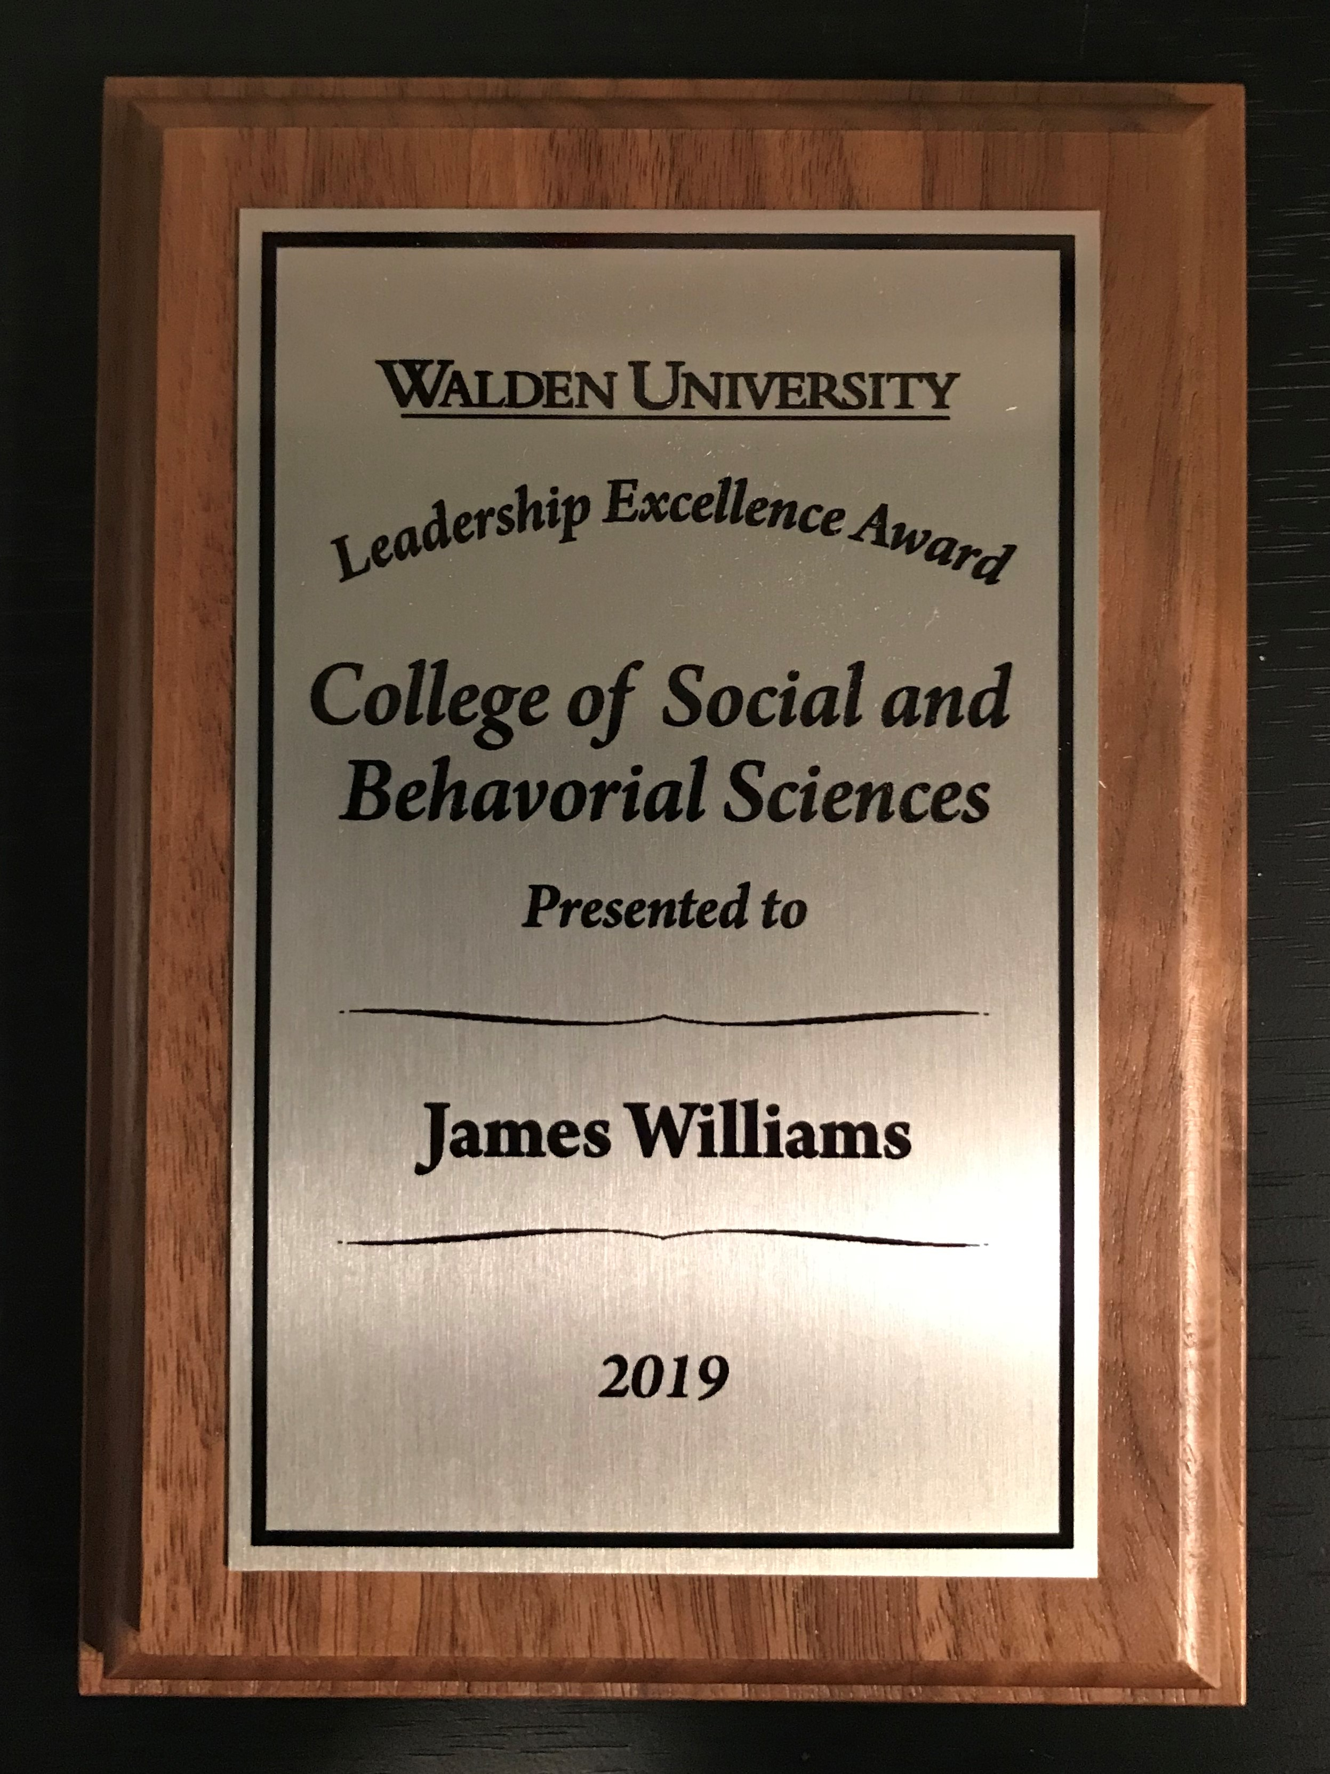
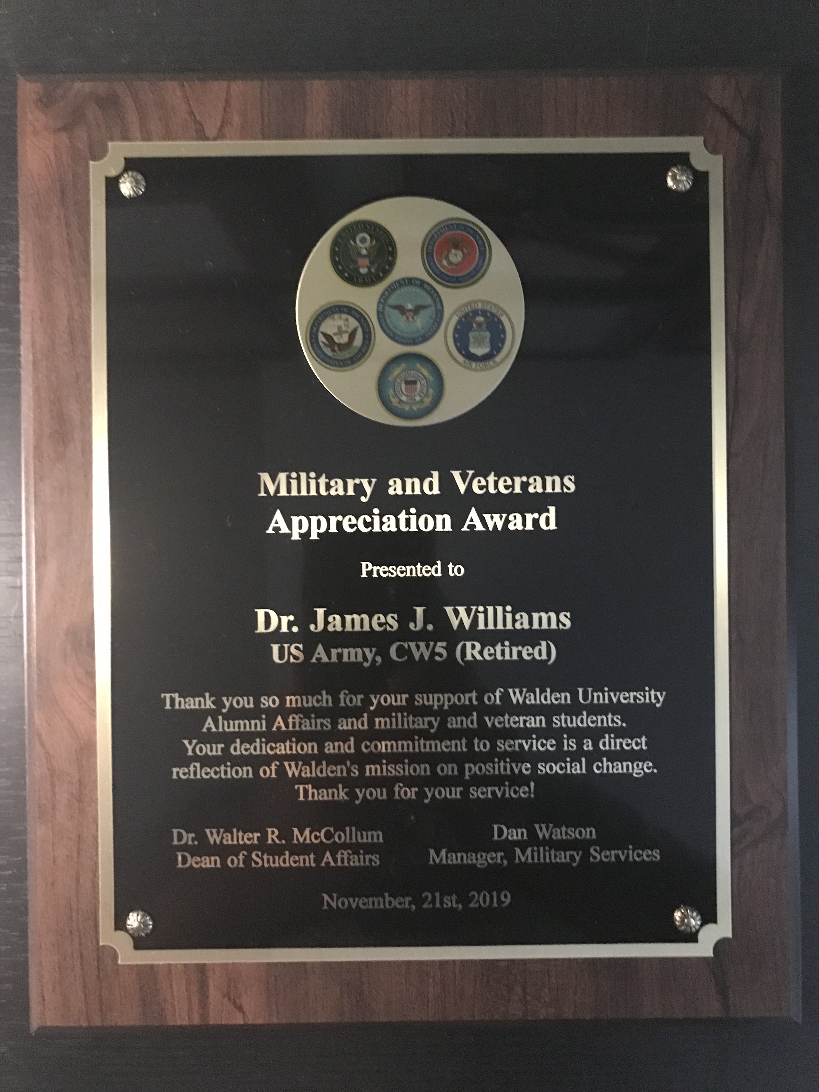
Notes:
Put your notes here as memory guides

Slide 16
Until the lions have their own historians…
the history of the hunt will always glorify the hunter!
- Chinua Achebe -

Slide 17
Rising Above the Fray - INTERVIEWEES
Name | Rank | Total Yrs | MOS | Confirmed | Location | Venue | Lodging | Gender | Notes
Chiles | CW4-R | 38 | 270A | COMPLETE | CA | Y | Y | M | Author/Historian
Davis | CW5-R | 42 | 915A | COMPLETE | TX | Y | Y | M | CEO/Franchisee(or)
Graves-R | CW5-R | 41 | 920A | COMPLETE | FL | Y | Y | F | Retired/Retired
Haynes | CW5-R | 30 | 420A | COMPLETE | GA | Y | Y | M | Haynes Foundation
Lewis III | CW5-A | 28 | 948E | COMPLETE | AL | Y | Y | M | Deputy Cmdt/WOCC
Rucker | CW5-R | 30 | 255Z | COMPLETE | TX | Y | Y | M | CEO - Trecig, LLC
Turner | CW5-R | 28 | 881A | COMPLETE | DMV-VA | Y | N/A | M | Entrepreneur/Author
Tyree H-H | CW5-R | 35 | 420A | COMPLETE | AL | Y | Y | F | Attorney/1st Lady
Woodyard | CW5-R | 31 | 915E | COMPLETE | DMV-VA | Y | Y | F | BOSS Lady/Producer
Williams | CW5-R | 40 | 153C | COMPLETE | DMV-VA | Y | N/A | M | 1st Army SWO (RET)
Williams | CW5-R | 31 | 420A | TBD | DMV-MD | Y | N/A | M | Scholar/Filmmaker
Young | CW5-R | 29 | 311A | COMPLETE | DMV-VA | Y | N/A | M | Retired/Retired

Slide 18
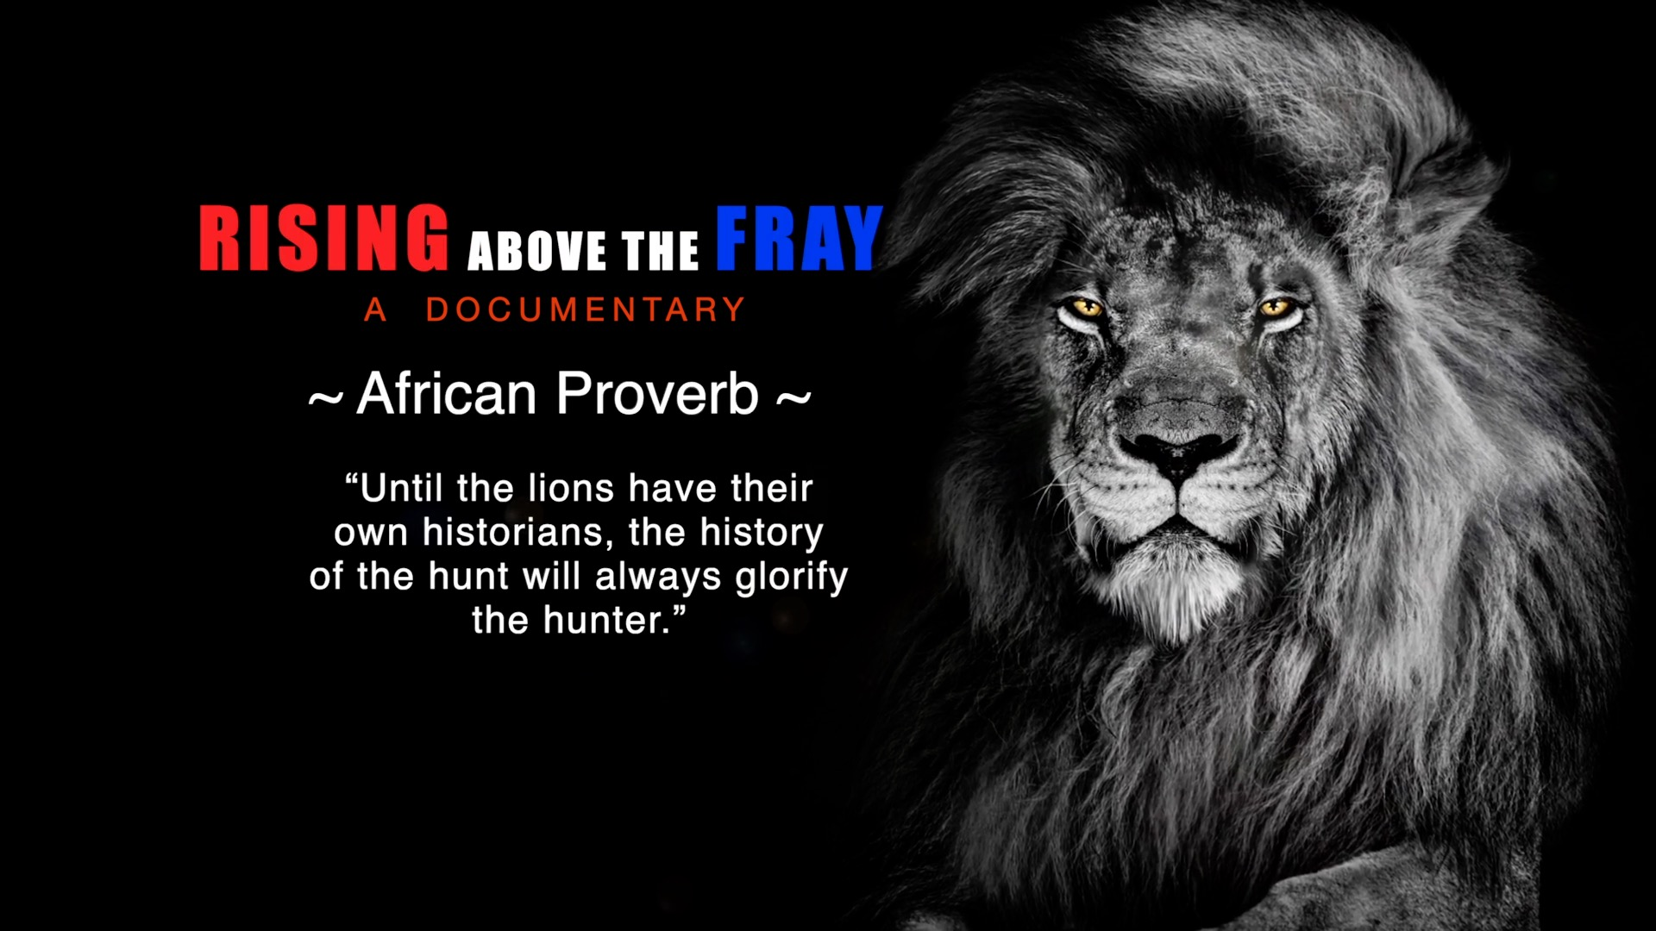

Slide 19
Contact Information
JAMES J. WILLIAMS, PhD
Scholar – Author – Speaker – Veteran
Email: jjwilliamsphd@gmail.com
LinkedIn: /in/james-j-williams
Twitter: @jjwilliamsphd

